Slide 1
CODD’s 12 RULES OF RELATIONAL DATABASE

Slide 2
OVERVIEW OF CODD’s RULE
A relational database management system (RDBMS) is a database management system (DBMS) that is based on the relational model as introduced by E. F. Codd.
A short definition of an RDBMS may be a DBMS in which data is stored in the form of tables and the relationship among the data is also stored in the form of tables.
E.F. Codd, the famous mathematician has introduced 12 rules (0-12)for the relational model for databases commonly known as Codd's rules. The rules mainly define what is required for a DBMS for it to be considered relational, i.e., an RDBMS.

Slide 3
Rule 0
This rule states that all subsequent rules are based on the notation that in order for a database to be considered relational, it must use it’s relational facilities exclusively to manage the database.

Slide 4
Rule 1: INFORMATION RULE
All information in the database is to be represented in one and only one way.
All information in an RDB is represented as values in the tables.
This is achieved by values in column and rows of tables.
All information including table names, column names and column data types should be available in same table within the database.
The basic requirement of the relational model.

Slide 5
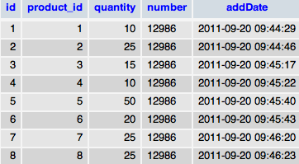

Slide 6
Rule 2: GUARANTEED ACCESS RULE
Each unique piece of data should be accessible by:table name+primary key(row) + attribute(column).
All data are uniquely identified and accessible via this identity.
Most RDBMS do not make the definition of the primary key mandatory and are deficient to that extent .

Slide 7
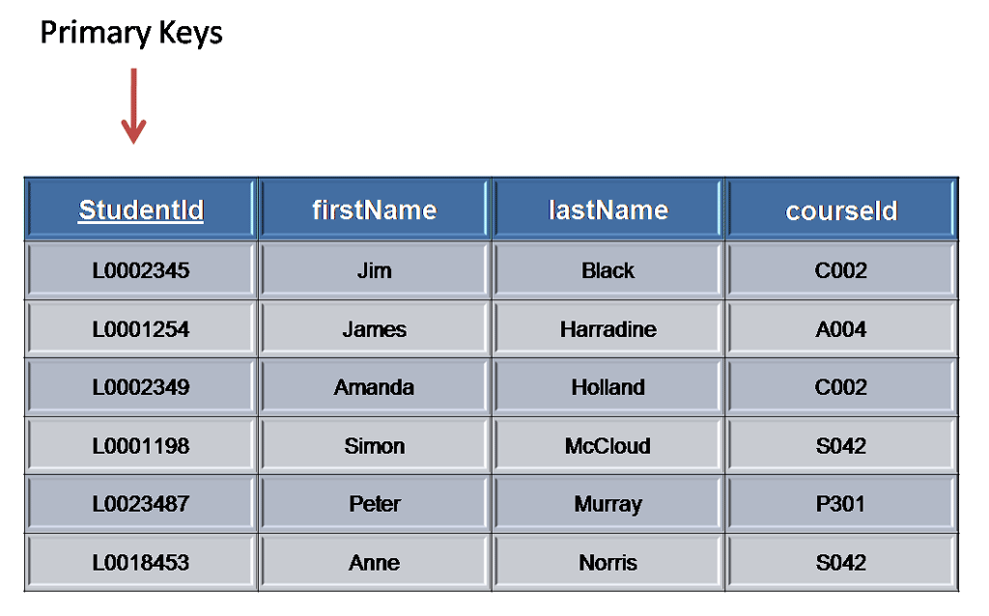

Slide 8
Rule 3 : Systematic treatment of null values
"Null values (distinct from the empty character string or a string of blank characters and distinct from zero or any other number) are supported in fully relational DBMS for representing missing information and inapplicable information in a systematic way, independent of data type."

Slide 9
NULLs may mean: Missing data, Not applicable
Should be handled consistently - Not Zero or Blank
Primary keys — Not NULL
Expressions on NULL should give NULL.
Separate handling of missing and/or non applicable data.
This is distinct to zero or empty strings

Slide 10
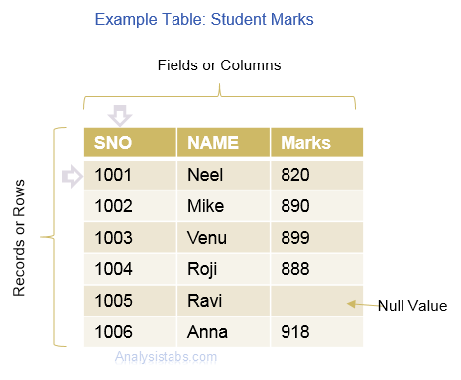

Slide 11
Rule 4:DATABASE DESCRIPTION RULE
The data base description is represented at the logical level in the same way as-ordinary data, so that authorized users can apply the same relational language to its interrogation as they apply to the regular data.
The authorized users can access the database structure by using common language i.e. SQL

Slide 12
Rule 5: COMPREHENSIVE DATA SUBLANGUAGE
A relational system may support several languages and various modes of terminal use .However, there must be at least one language whose statements are expressible, per some well-defined syntax, as character strings and that is comprehensive in supporting all the following items :

Slide 13
Data Definition (create,insert,update)
View Definition
Data Manipulation (alter,delete,truncate)
Integrity Constraints (primary key,foreign key,null values)
Authorization (GRANT , REVOKE)
Transaction boundaries (begin,commit,rollbacketc)
Every RDBMS should provide a language to allow the user to query the contents of the RDBMS and also manipulate the contents of the RDBMS.

Slide 14
Rule 6: VIEW UPDATING RULE
View = ”Virtual table”, temporarily derived from base tables.
Example: If a view is formed as join of 3 tables, changes to view should be reflected in base tables.
Not updatable: View does not have NOT-NULL attribute of base table.
It allow the update of simple theoretically updatable views, but disallow attempts to update complex views.

Slide 15
BELOW IS A TABLE NAMED ‘STUDENT‘.
RDBMS GIVES US THE FACILITY TO VIEW ONLY SOME PARTICULAR FIELDS ACCORDING TO OUR NEED WHICH ARE DIRECTLY ACCESSED FROM BASE TABLES WHEN REQUIRED.
name | class | Marks | PUPIN NUMBER
SONALI | BCA-2 | 95 | 17231
TAMANNA | BCA-2 | 90 | 17236
RAJWINDER | BCA-2 | 90 | 17267
SAKSHI | BCA-2 | 86 | 17893
SADHANA | BCA-2 | 82 | 17453

Slide 16
TO VIEW ONLY THE NAME AND MARKS OF THE STUDENT TABLE WE CAN WRITE THE FOLLOWING SYNTAX:
CREATE VIEW RECORD
AS SELECT NAME,MARKS FROM STUDENT;
VIEW IS CREATED.
SELECT * FROM RECORD;
name | Marks
SONALI | 95
TAMANNA | 90
RAJWINDER | 90
SAKSHI | 86
SADHANA | 82

Slide 17
RULE 7
HIGH-LEVEL INSERT,UPDATE AND DELETE

Slide 18
RULE 7 : HIGH-LEVEL INSERT , UPDATE AND DELETE
This rule states that insert, update, and delete operations should be supported for any retrievable set rather than just for a single row in a single table.
It also perform the operation on multiple row simultaneously .
There must be delete, updating and insertion at the each level of operation. Set operation like union, all union , insertion and minus should also supported.
EXAMPLE:
Suppose if we need to change ID then it will reflect everywhere automatically.

Slide 19
EXAMPLE
TABLE CREATED
Create table:
SQL>CREATE TABLE STUDENT_DATA
{
NAME VARCHAR 2(20),
ROLL_NO VARCHAR 2(10
),
CLASS VARCHAR 2(20);
};
INSERT ION:
SQL>INSERT INTO STUDENT_DATA(‘&NAME’,&ROLL_NO,’&CLASS’);
SQL>ENTER VALUE FOR NAME:KIRAN
SQL>ENTER VALUE FOR ROLL_NO:4556
SQL>ENTER VALUE FOR CLASS:BCA
SQL>/
NAME | ROLL_NO | CLASS
NAME | ROLL_NO | CLASS
KIRAN | 4566 | BCA
RAHUL | 3455 | BCA

Slide 20
RULE 8
LOGICAL DATA INDEPENDENCE

Slide 21
RULE 8 :LOGICAL DATA INDEPENDENCE RULE
What is independence?
The ability to modify schema definition in on level without affecting schema definition in the next higher level is called data independence
The ability to change the logical (conceptual) schema without changing the External schema (User View) is called logical data independence.
EXAMPLE:
The addition or removal of new entities, attributes, or relationships to the conceptual schema should be possible without having to change existing external schemas or having to rewrite existing application programs.

Slide 22
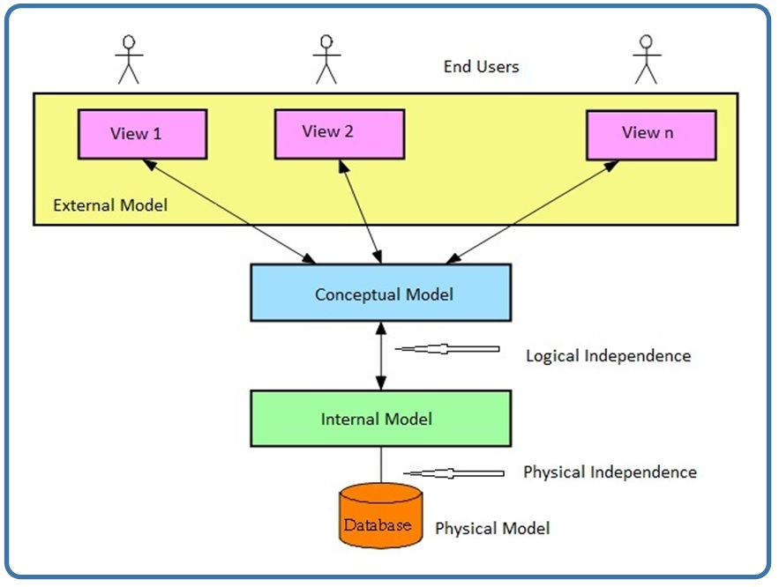

Slide 23
PHYSICAL DATA INDEPENDENCE
RULE 9

Slide 24
RULE 9:PHYSICAL DATA INDEPENDENCE
The ability to change the physical schema without changing the logical schema is called physical data independence.
This is saying that users shouldn’t be concerned about how the data is stored or how it’s accessed. In fact, users of the data need only be able to get the basic definition of the data they need.
EXAMPLE:
A change to the internal schema, such as using different file organization or storage structures, storage devices, or indexing strategy, should be possible without having to change the conceptual or external schemas.

Slide 25
RULE 10
INTEGRITY INDEPENDENCE RULE

Slide 26
RULE 10 : INTEGRITY INDEPENDENCE RULE
Data integrity refers to maintaining assuring the accuracy and consistency of data over its entire life cycle.
First insure that correct data type is used.
Check constraints: these allow column value to be checked agenized other column before insertion is allowed.

Slide 27
RULE 11
DISTRIBUTION INDEPENDENCE RULE

Slide 28
RULE 11 : DISTRIBUTION INDEPENDECE RULE
“THE RELATION DATA BASE MANAGEMENT HAS DISTRIBUTION INDEPENDENCE”
Distribution independence implies that user should not have to be aware of whether a database is distributed at different sites or not.
Application program and adhoc request are not affected by the change in distribution of physical data. Application program will work even if the programs and data are moved on different site
The RDBMS may spread across the more one system or several networks

Slide 29
RULE 12
NON-SUBVERSION RULE

Slide 30
RULE 12 : NON-SUBVERSION RULE
There should be no way to modify to database structure other then through the multiple row data base language(SQL).
Example:
A relational system has a low-level (single-record-at-a-time) language, that low level cannot be used to subvert or bypass the integrity Rules and constraints expressed in the higher level relational language (multiple-records-at-a-time).”

Slide 31
MULTIPLE
CHOICE
QUESTIONS

Slide 32
Question 1
What is true regarding NULL value requirements confirming to Codd rule?
a. Null value should be zero. b. Null value should be space. c. Null value should represent missing information. d. Either a or b.
Answer :
c. Null value should represent missing information. According to Codd rule, Null value should not be any regular data like zero, spaces etc, but should represent that data is not available.

Slide 33
Question 2
According to Codd rule, how one should be able to access information about data structures like databases, tables etc.
a. Should be directly accessible via all programming languages. b. Should be directly accessible via same query language used for data manipulation (e.g. select, update statements etc) c. Should be directly accessible via XML d. All of the above
Answer :
b. Should be directly accessible via same query language used for data manipulation. For example, SQL can be used to retrieve information about the tables, the column types etc.

Slide 34
Question 3
Which is true regarding multi row update?
a. Multiple row updates should be prohibited. b. Multiple row updates should be allowed only on tables without null values. c. Multiple row updates should be possible. d. Multiple row updates should be allowed only on integer data types
Answer :
c. Multiple row updates should be possible.

